Slide 1
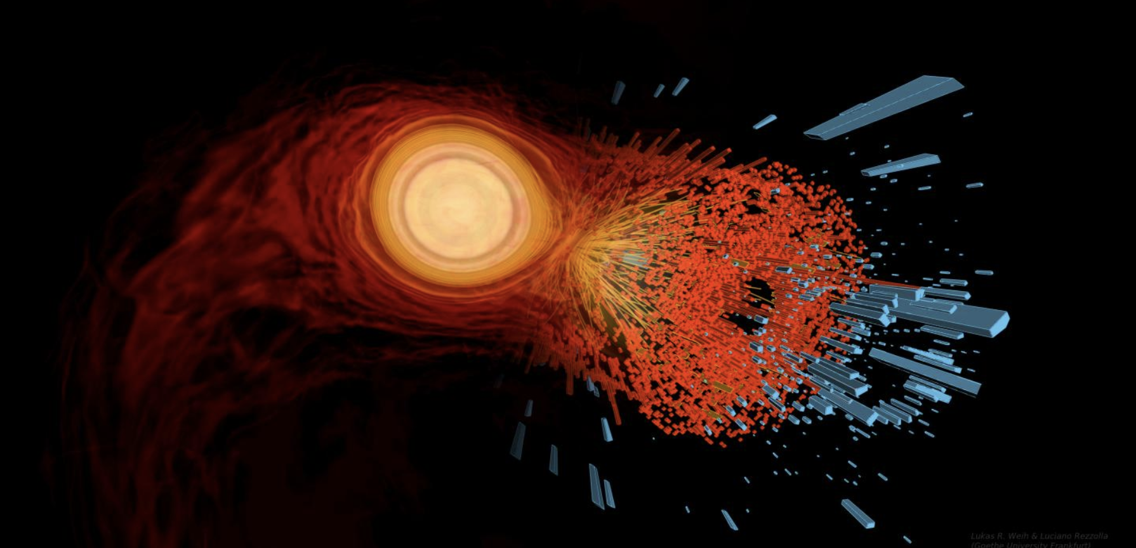
Modules overview
Dr. Johannes Jahan
University of Houston
on behalf of Prof. Claudia Ratti
Collaboration meeting
May 17, 2024
Notes:
Hello everyone, I am […], working at […] as […], and it is a pleasure to give this talk today about the status of the MUSES project, on behalf of the MUSES collaboration.

Slide 2
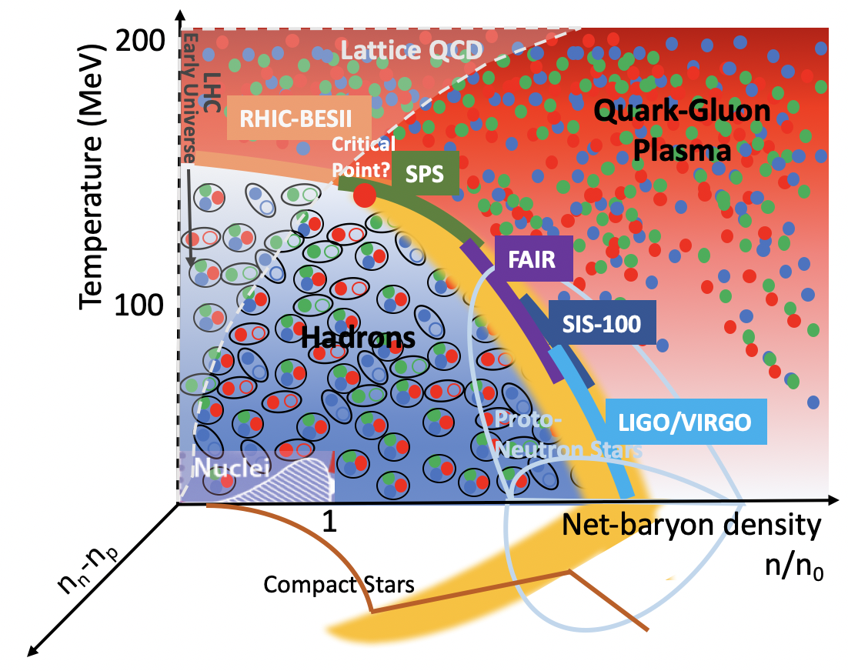
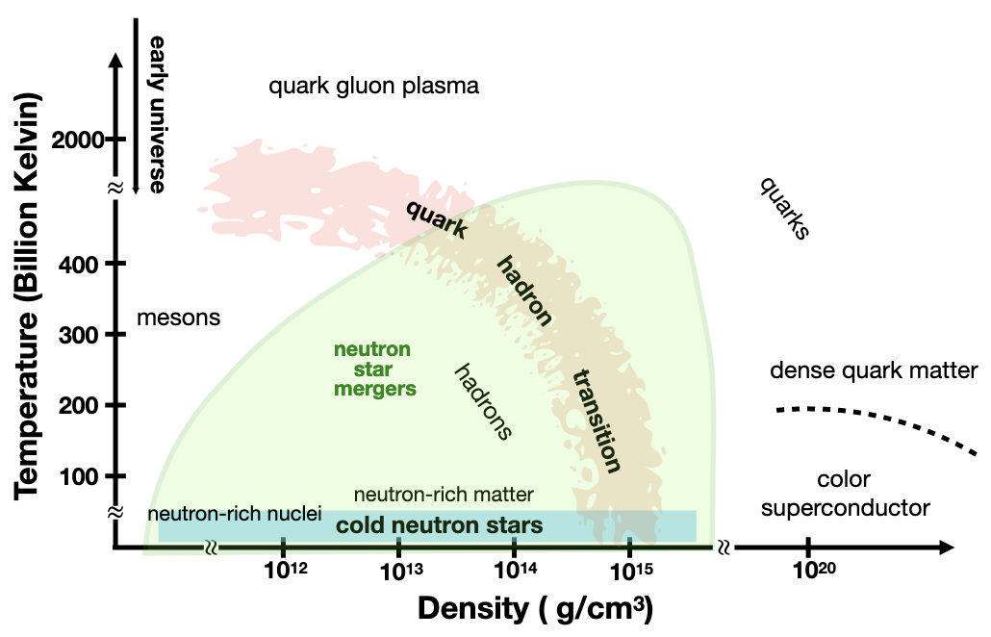
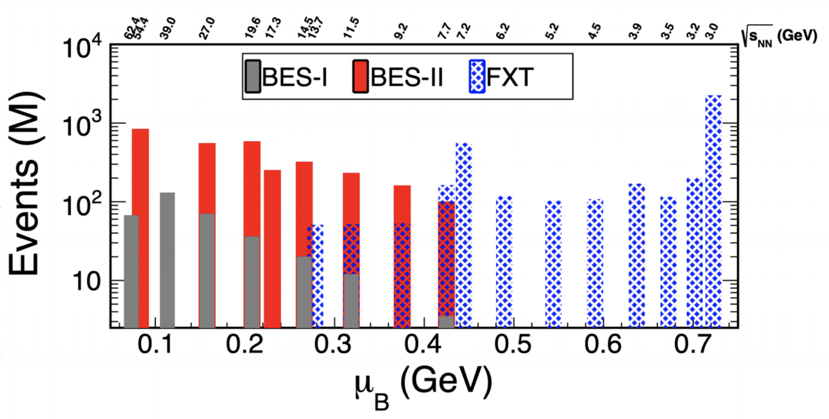
Motivating science goals
Run 2019:
Collider: √s_{NN}=14.6, 19.6, 200 GeV
Fixed target: √s_{NN}=3.2 GeV
Run 2020:
Collider: √s_{NN}=9.2, 11.5 GeV
Fixed target: √s_{NN}=3.5, 3.9, 4.5, 5.2, 6.2, 7.2, 7.7 GeV
Run 2021:
Collider: √s_{NN}=7.7, 17.3 GeV
Fixed target: √s_{NN}=3.0, 9.2, 11.5, 13.7 GeV
Where is the transition line at high density?
Is there a critical point in the QCD phase diagram?
What are the degrees of freedom in the vicinity of the phase transition?
What are the phases of QCD at high density?
How are heavy nuclei created and what is the site of the r-process?
2
Notes:
Let's start with reminding some of the questions we are trying to answer when studying strongly interacting matter under extreme conditions [LIST QUESTIONS 1-3]. On the cartoon of the QCD phase diagram: compilation of experimental facilities and the regions of the phase diagram that they are supposed to explore. Most imminent results from the RHIC BES-II (just finished its runs in 2021) ; soon, results covering these collision energies and chemical potentials will be published. Exciting thing about this plot: there is also a corner (high density + low temperatures) where information from NS and mergers can help us to map out the phase diagram, and help us answering the following questions: [LIST QUESTIONS 4-5].

Slide 3
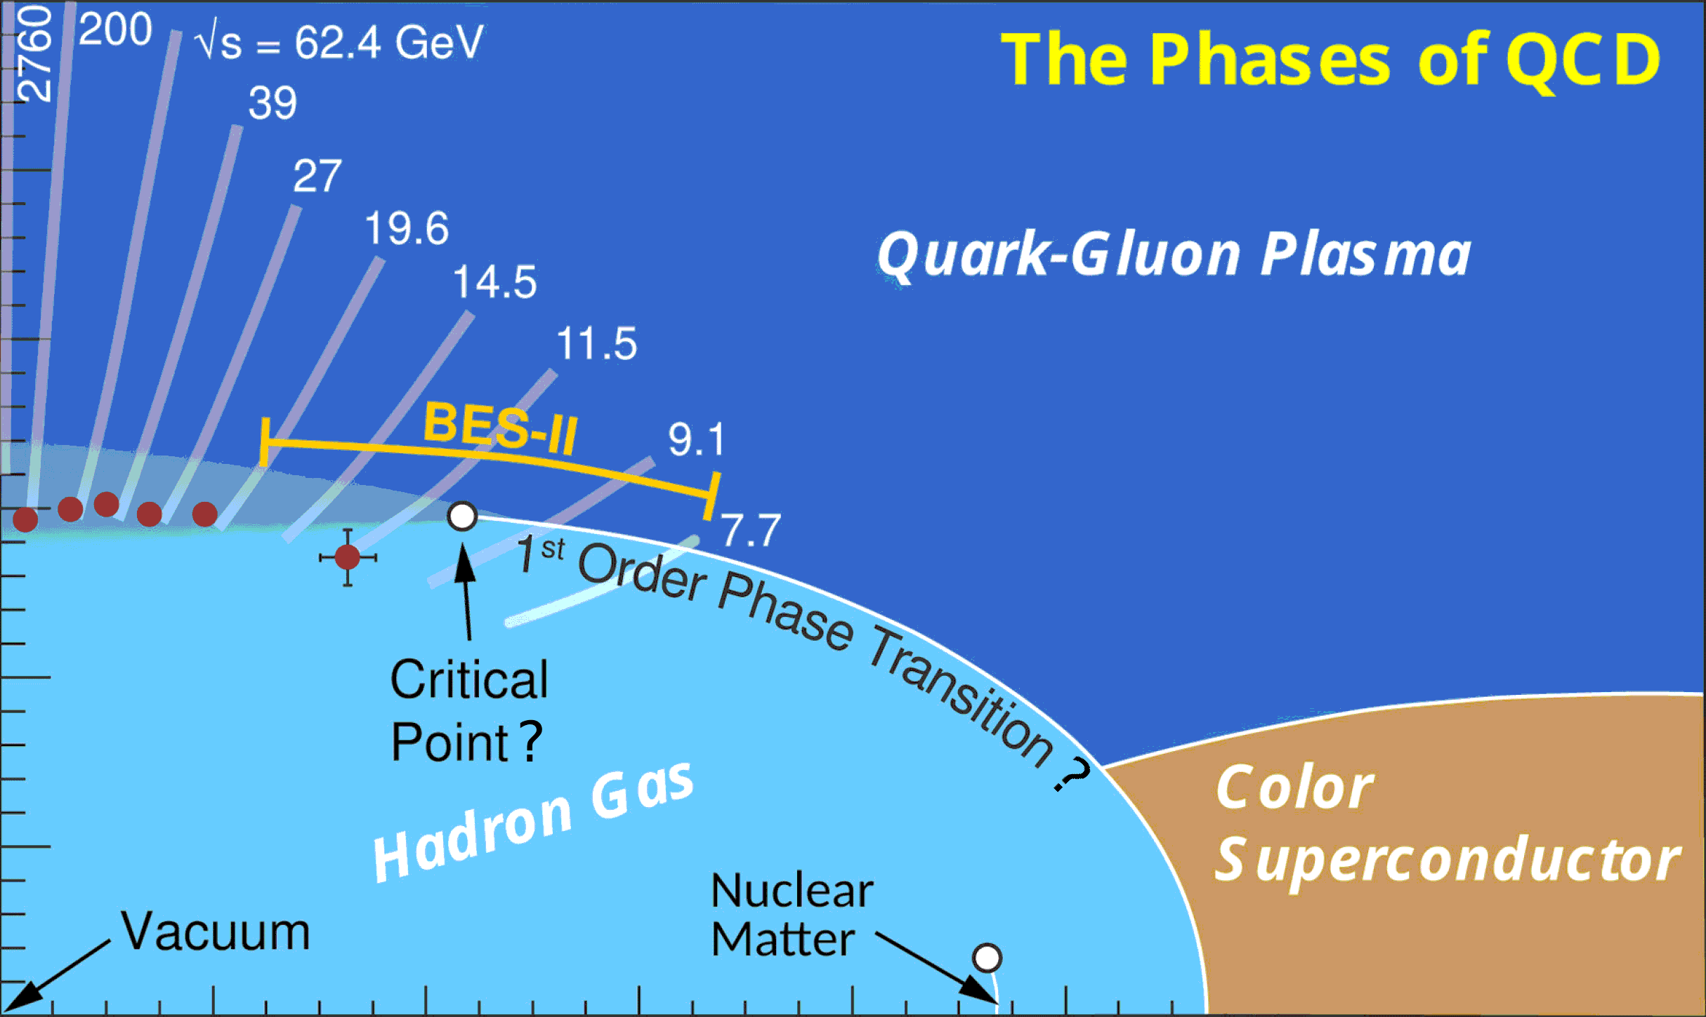
What happens at Finite densities?
Perturbative QCD
Lattice QCD
Holography
From 1st principles calculation, lattice QCD only covers the low-density region.
Deconfined quarks
We need to merge the lattice QCD EoS with other effective theories
Careful study of their respective range of validity
Quarkyonic
Matter?
Chiral EFT
Color
Superconductor?
Liquid-Gas, Nuclei
Could we try to merge them
together to ensure full coverage
of the phase diagram ?
Lattice QCD: S. Borsanyi, C. R. et al, PRL (2021)
pQCD: Andersen et al., PRD (2002); Annala et al., Nat. Ph. (2020)
Interacting HRG: V. Vovchenko et al., PRL (2017)
Quarks: Ratti et al., PRD (2006), Dexheimer et al., PRC (2009);
Baym et al., Astr. J. (2019)
Liquid-gas, Nuclei: see e.g. Du et al. PRC (2019)
Chiral EFT: see e.g. Holt, Kaiser, PRD (2017)
Quarkyonic: McLerran et al. (2007, Vovchenko et al. (2023)
Holography: R. Critelli, C. R. et al., PRD (2017)
CSC: Alford et al., PLB (1998); Rapp et al., PRL (1998);
S. Rossner, C. R. et al, PRD (2007).
3
Notes:
Let's go back on the phase diagram, and discuss how it can be described theoretically. We know that lattice QCD simulations, based on 1st principles QCD calculations, can only be achieved at 0 chemical potentials and then be extrapolated to cover the low-density region of the phase diagram. But what do we do about the rest..? -> We need to resort to effective theories or models. At low T / intermediate densities: - DOFs should be interacting hadrons - we know there is a liquid-gas phase transition - chiral effective field theory is the low-energy theory of QCD In the deconfined phase at intermediate T / finite density: - holographic approaches describe the strongly coupled QGP At very large T and mu_B: - we recover pQCD In the very dense and hot area: - models with deconfined quarks + more exotic phases such as quarkyonic matter / color superconductivity. There is hence a lot of knowledge that goes into all the different phases of matter on this phase diagram, and one can think of putting them all together to achieve full coverage of the phase diagram.

Slide 4
MUSES – Modular Unified solver of the Equation of state
“An open-source cyberinfrastructure fostering a community-driven ecosystem that provides key computational tools to promote, transform and support groundbreaking research in nuclear physics and astrophysics, computational relativistic fluid dynamics, gravitational-wave and computational astrophysics.”
Modular: while at low densities the equation of state is known from 1st principles, at high μ_{B} we will implement different models (“modules”) that the user will be able to pick
Unified: the different modules will be smoothly merged together to ensure maximal coverage of the phase diagram, while respecting established limiting cases (lattice, perturbative QCD, Chiral EFT…)
4
Notes:
This is how MUSES was envisioned. MUSES stands for Modular Unified Solver of the Equation of State and it will deliver an open-source cyberinfrastructure [...]. Modular means that, especially at large chemical potentials, we will implement different choices for the equation of state, or modules, that the user will be able to choose. Unified means that the different modules will be provided with tools to smoothly merge together different EoS to ensure maximal coverage of the phase diagram.

Slide 5
MUSES goals and milestones
CyberInfrastructure of interoperating tools and services within a replicable and flexible deployment system
Upgrade of existing calculation tools to modern programming languages
Equation of State (EoS) package that combines all the EoS modules using smooth transition functions
Observables package to compute different observables and provide tools to facilitate comparison with experiments
Web-based tools and services that provide interactive interfaces to the calculation engine
Job management system and a deployment system that can be reproduced in other computing environments
5
Notes:
The goals and milestones of MUSES are to develop a cyberinfrastructure of interoperating tools and services with a replicable and flexible deployment system. We will: - upgrade existing calculation tools to modern programming languages - develop the EoS package that can combine different EoS modules that you can see here (as well as using smooth transition functions between them to maximize the coverage oh the phase diagram) - develop an observable & tools package, that will provide some tools (interpolation, EoS inversion) and ways to compute useful observables for the users from heavy-ion and astrophysics communities
- develop web-based tools and services for the users, that provide interactive interfaces to the calculation engine - introduce a job management system that executes the calculations requested by the users, using the best available processing system, and a deployment system that can be downloaded and run locally (Docker)

Slide 6
Alpha-release: May 2024
DETAILS
1st set of modules will be released on this date
They will be open-source, but preliminary
We will invite interested people to test these modules and give us feedback
The modules to be released will be marked by during this talk
α-RELEASE
6
Notes:
In the case of Neutron Stars and their mergers, studying such systems usually requires to consider... [DETAILS]. Hence, we need in that case to provide to the community... [NEEDS].

Slide 7
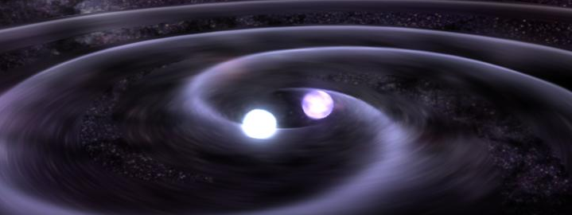
Eos for Neutron stars
Insert : https://www.google.com/search?sxsrf=APwXEddfRz9MFIWVWU43LOd-2tDCpNGJ3Q:1687448488980&q=neutron+star+binary+merger&tbm=isch&sa=X&ved=2ahUKEwjcmYy-m9f_AhUGKewKHXl_BZQQ0pQJegQIDRAB&biw=1396&bih=656&dpr=1.38#imgrc=IoFiVyC5VPI1nM
NASA Scientific Visualization Studio
Chiral Mean Field Model
QHC19
UTK EOS
Chiral effective theory
7
Notes:
Going to higher densities, the neutron star Equation of State working group will include several models for the high-density, low-temperature region of the phase diagram.

Slide 8
Neutron stars & mergers: details
and needs
DETAILS
Long lifetime
Weak interaction must be considered
Flavor is driven out of equilibrium temporarily (mergers)
Electrically neutral for stability <ρ_{Q}>=0
NEEDS
Standard EoS: (p, s, ε, ρ_{B}, c_{s}², μ_{i}, Y_{i})
T=0 EoS for mergers and neutron stars
Finite-T EoS for mergers
Lepton EoS
Flavor equilibration tied to microscopic EOS models
8
Notes:
In the case of Neutron Stars and their mergers, studying such systems usually requires to consider... [DETAILS]. Hence, we need in that case to provide to the community... [NEEDS].

Slide 9
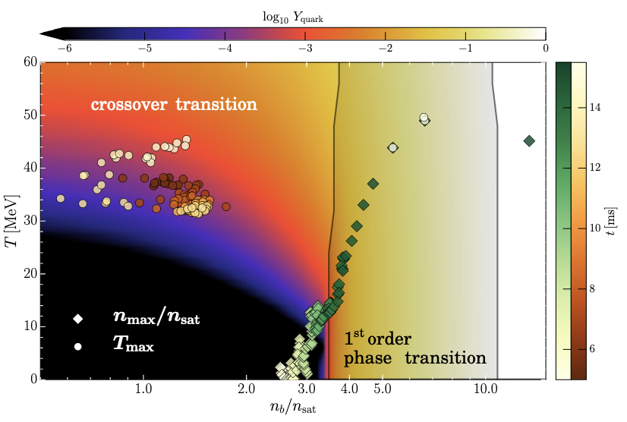
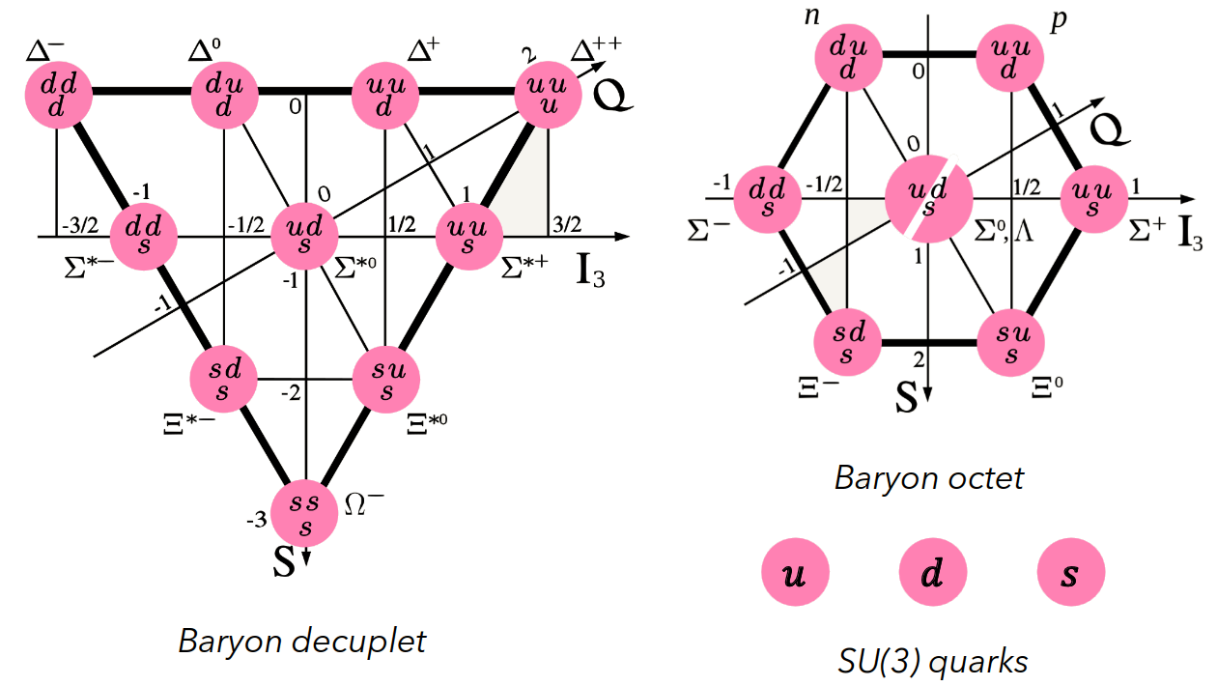
Multi-phase Equation of state for neutron stars
Dexheimer's groups
Range: 0 < T < 160 MeV ; μ_{B} < 1000 MeV
Chiral Mean Field (CMF) model
Crossover at low density and first-order phase transition at high density
Based on non-linear sigma model with the addition of deconfined quarks
Reproduces nuclear & astrophysics constraints, and matches pQCD in relevant regimes
Available for T=0 only (so far)
α-RELEASE
V. Dexheimer, S. Schramm, PRC (2009)
E. Most, V. Dexheimer et al., PRL (2019)
Outlooks:
Add finite-T extension
Add magnetic field
Thermal meson interactions
Study sensitivity of parameters
9
Notes:
Here are summarised all the different EoS that will be included to describe the region of the phase diagram relevant for NS and mergers study: - Chiral Mean Field (CMF) model, which features a crossover at low density and a first-order phase transition at high density
Based on the non-linear sigma model with addition of deconfined quarks, it reproduces several astrophysical constraints it matches pQCD in relevant regime - Another model including both hadronic and quark DOFs is the so-called QHC19 model (G. Baym et al.) It includes a hadronic phase which describes non-uniform and uniform matter + beta-equilibrium, and a quark matter phase based on NJL model with vector interaction -> Will be integrated after optimisation too, but only for the NJL part (deconfined quarks) at first

Slide 10
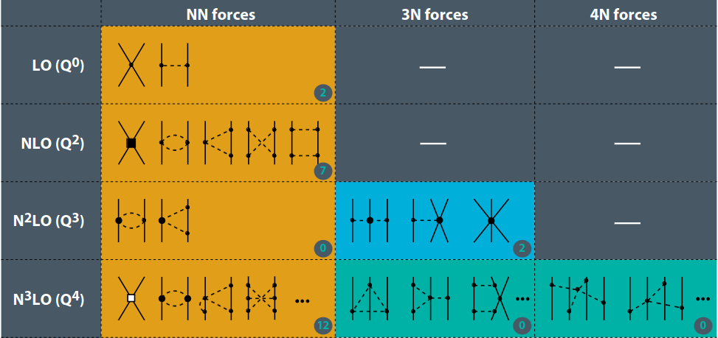
Hadronic Equations of state for neutron stars
Holt's group
Range: T ~ 0 MeV ; μ_{B} < 1000 MeV
Chiral effective field theory (ChiEFT)
Interacting nucleons and pions within chiral effective field theory
Fitted to nucleon scattering data and boundstate po
Proton fraction: 0 < Y_{p} < 0.5
α-RELEASE
J. Holt & N. Kaiser, PRC (2017)
α-RELEASE
Outlooks:
Add extension at finite-T (up to 30 MeV)
Include a wider variety of ChiEFT potentials
Provide uncertainty quantification
10
Notes:
We also have 2 purely hadronic models: - UTK, developed by Andrew Steiner et al., contains nucleonic degrees of freedom. - ChiEFT, developed by Jeremy Holt et al., contains interacting nucleons and pions within chiral EFT. So, the users will be able to choose which equation of state to implement, in which range of T and mu and our calculational engine will spit it out.

Slide 11
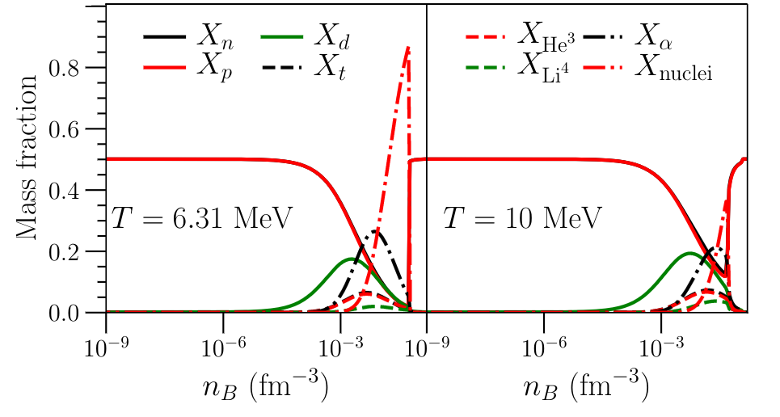
Hadronic Equations of state for neutron stars
Holt/Steiner's groups
Range: T~0 MeV ; μ_{B} < 1000 MeV
University of Tennessee in Knoxville (UTK) EoS
Includes nucleonic degrees of freedom based on a phenomenological fit of free energy density to nuclear experiments & astronomical observations
Covers densities from 10⁻¹² to 2 fm⁻³
α-RELEASE
Y_{e} = 0.5
X. Du, A. Steiner, J. Holt, PRC (2019)
X; du, A. Steiner, J Holt, PRC 110 (2022)
Outlooks:
Addition of finite T equations of state
Extension to strangeness degrees of freedom
Machine learned emulator
11
Notes:
We also have 2 purely hadronic models: - UTK, developed by Andrew Steiner et al., contains nucleonic degrees of freedom. - ChiEFT, developed by Jeremy Holt et al., contains interacting nucleons and pions within chiral EFT. So, the users will be able to choose which equation of state to implement, in which range of T and mu and our calculational engine will spit it out.

Slide 12
EoS for Heavy ions
MADAI collaboration
EoS from first principles
EoS with 3D Ising critical point
HRG model
EoS from Holography
12
Notes:
Given this premise, let me now introduce the working groups and tell you what each one of them will be producing.
We start from the heavy-ion working group, which covers the small-to-intermediate region of the phase diagram.

Slide 13
Heavy ion collisions: details
and needs
DETAILS
System is described in terms of hydrodynamic simulations and/or microscopic transport
System is not in equilibrium, short lifetime
Strangeness neutrality <n_{S}>=0 + locally conserved
Charge: p vs. n in ions <n_{Q}>=0.4<n_{B}>
NEEDS
To take into account local fluctuations, 4D Equations of State are needed
Free parameters: T, μ_{B}, μ_{S}, μ
Thermodynamic variables (p, s, ε, n_{B}, c_{s}²)
1st and 2nd order derivatives of pressure with respect to chemical potentials
Inclusion of critical point
Transport coefficients
Notes:
From the experiments, we know that we have the following constraints... [DETAILS]. Hence, we need to provide to the community... [NEEDS].

Slide 14
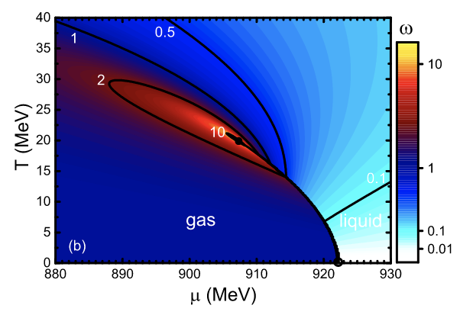
Hadron resonance gas (HRG) model
Vovchenko/Noronha-Hostler/Ratti’s groups
Range: 0 < T < 160 MeV ; μ_{B} < 1000 MeV
HRG model provides a well-established and realistic EoS at low temperatures
Ideal version is based on the assumption that an interacting gas of hadrons in the ground state can be well-approximated by an ideal gas of resonances
At large density, we need to incorporate additional interactions (van Der Waals)
Describes the liquid-gas phase transition
Goals:
Implementing FIST into module for thermodynamics results
Give flexibiliy on the particle list as input
Extend hadronic spectrum to the most updated PDG list
V. Vovchenko, H. Stoecker & M. Gorenstein., PRL (2017)
V. Vovchenko, H. Stoecker, Comput. Phys. Com. (2019)
Notes:
At low temperatures, where lattice QCD simulations are difficult, the HRG provides a good description of the thermodynamics of nuclear matter.
Its ideal version is based on the assumption that an interacting gas of hadrons in the ground-state can be well approximated by an ideal gas of hadrons and resonances. However, this description needs to be modified at large density to include additional interactions such as van der Waals, which are able to describe the liquid-gas phase transition. Goal: include the van der Waals HRG code from FIST into MUSES and fix the parameters to describe the liquid-gas critical point in a multi-component scenario (update using PDG2021+ list).

Slide 15
Equation of state from holography
Noronha/Ratti’s groups
Range: 30 MeV < T < 400 MeV ; μ_{B} < 1100 MeV
α-RELEASE
String theory/Classical gravity
in 5D
Quantum Field Theory
in 4D
By solving the equations of motion (EoM) for a 5D Einstein-Maxwell-Dilaton (EMD) model defined by the following action:
(simplest action reproducing a realistic 4D QCD EFT)
...one can obtain the following thermodynamic quantities by
using the UV behavior of the EMD fields
fixing free parameters Λ, κ₅ and the functional form of V(ϕ) and f(ϕ) by matching with lQCD results at µ_{B} = 0
15
Notes:
In order to get thermodynamics for QCD from Holography, one can use gauge/gravity correspondence from a 5D EMD model with the action shown here.

Slide 16
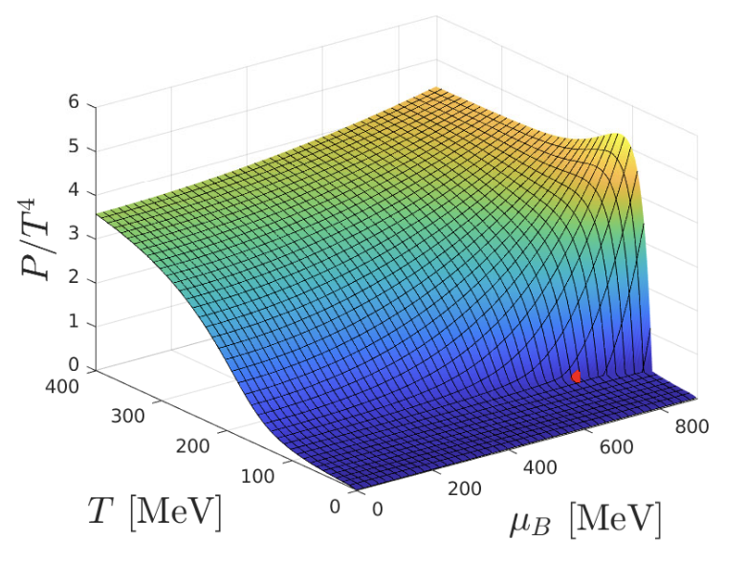
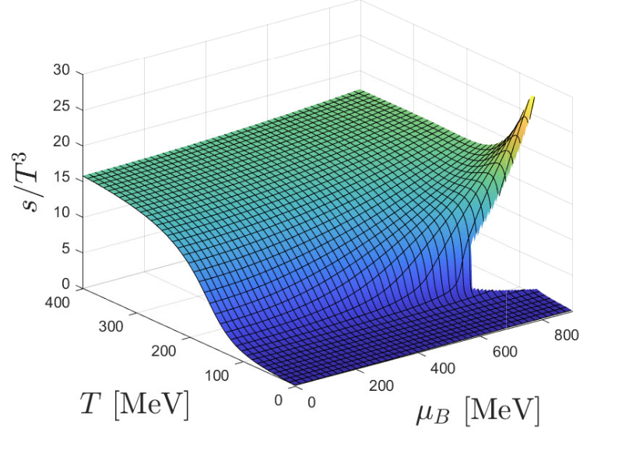
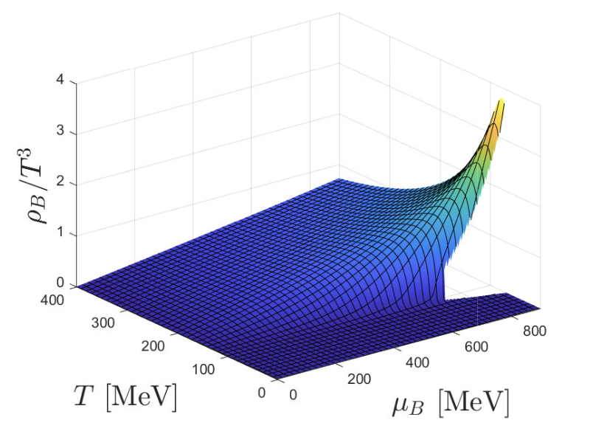
Equation of state from holography
Noronha/Ratti’s groups
Range: 30 MeV < T < 400 MeV ; μ_{B} < 1100 MeV
α-RELEASE
Fix the parameters to reproduce everything we know from the lattice
Calculate equation of state at finite density, but only for finite μ_{B}
Currently includes a critical point (T^{CEP} = 103.85 MeV ; μ_{B}^{CEP} = 599 MeV)
Outlooks:
Extension to multiple conserved charges
J. Grefa, C. Ratti et al., PRD (2021)
J. Grefa, C. Ratti et al., PRD (2022)
16
Notes:
Finally, another module which bridges the gap between HI and merger regimes is the EoS obtained from holography. This is based on an Einstein-Maxwell Dilaton Holographic model that reproduces lattice QCD results and transport properties of the QGP. Currently, the model only has 1 conserved charge (B), and predicts a CP at T=89 MeV / muB=723 MeV The next goal is to include > 1 conserved charge in this model.

Slide 17
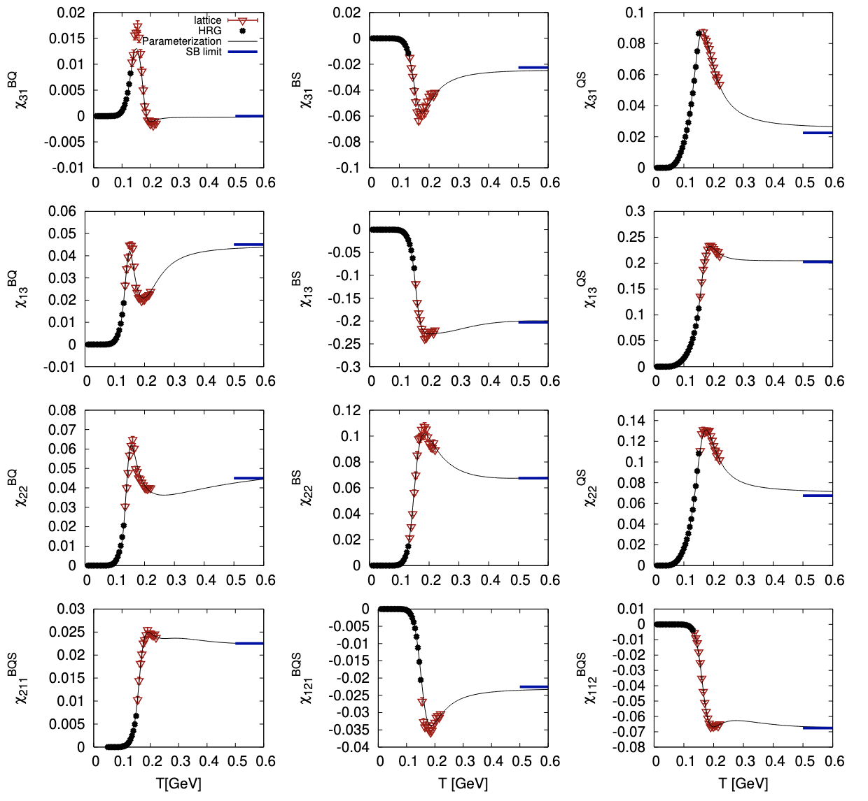
Ratti’s group
4D Equation of state from l-QCD (BQS-EoS)
α-RELEASE
α-RELEASE
Range: 30 MeV < T < 800 MeV ; μ_{B/Q/S} < 450 MeV
Full Taylor expansion needed to study different μ_{B/Q/S} scenarios
Parametrized susceptibilities fitted on lattice QCD + HRG
Coefficients are available from lattice-QCD up to global order 4 (μ/T < 2.5)
S. Borsanyi, C. R. et al., JHEP (2018)
J. Noronha-Hostler, C. R. et al., PRC (2019)
A. Monnai et al., PRC (2019)
Outlooks:
Add the case <n_{S}>=0 & <n_{Q}>=0.4<n_{B}>, for HICs
17
Notes:
This first module is designed to obtain an EoS from lattice QCD at finite T and mu_B, which can contain S and Q fractions that can be chosen by the user. We build a Taylor expansion of the pressure in powers of all three chemical potentials, which allow us to have a full 4-Dimensional EoS that can be trusted up to mu_{B,Q,S}/T ~ 2.5 To build this Taylor expansion, we need diagonal + off-diagonal coefficients, which are available from lattice QCD simulations up to global order 4 in the derivatives, and that are parametrized in this code to enable fast computing.

Slide 18
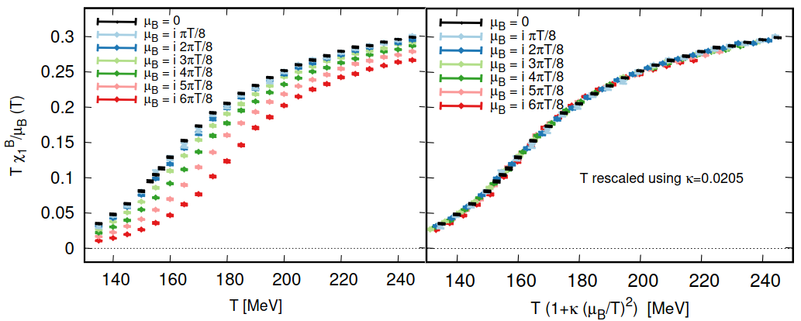
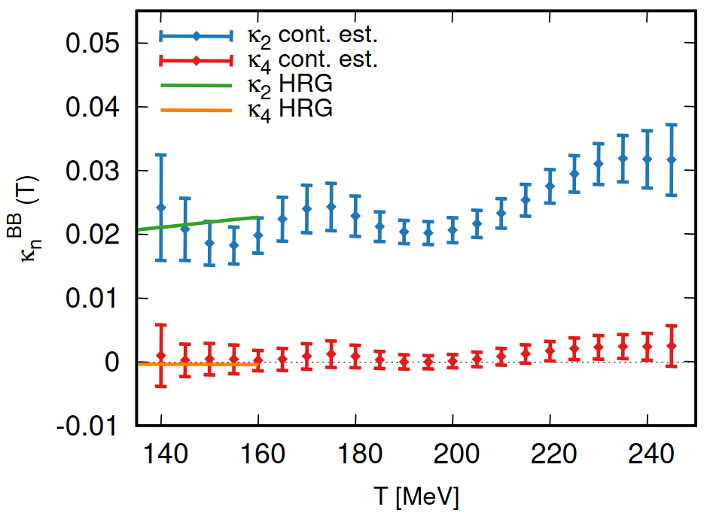
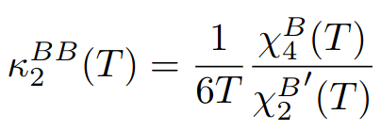
Ratti’s group
2D Ising-T.Ex.S Equation of state from l-QCD
α-RELEASE
Range: 30 MeV < T < 800 MeV ; μ_{B/Q/S} < 700 MeV
Empirical observation:
all 1st order susceptibilities scale when defining a µ_{B}-dependent temperature T'(T, µ_{B})
scales like:
Main identity
one can thus redefine temperature and use an alternative expansion scheme:
with alternative expansion coefficients κ, related to susceptibilities:
M. Kahangirwe, J.J., C. Ratti et al., PRD (2024); arXiv:2402.08636

Slide 19
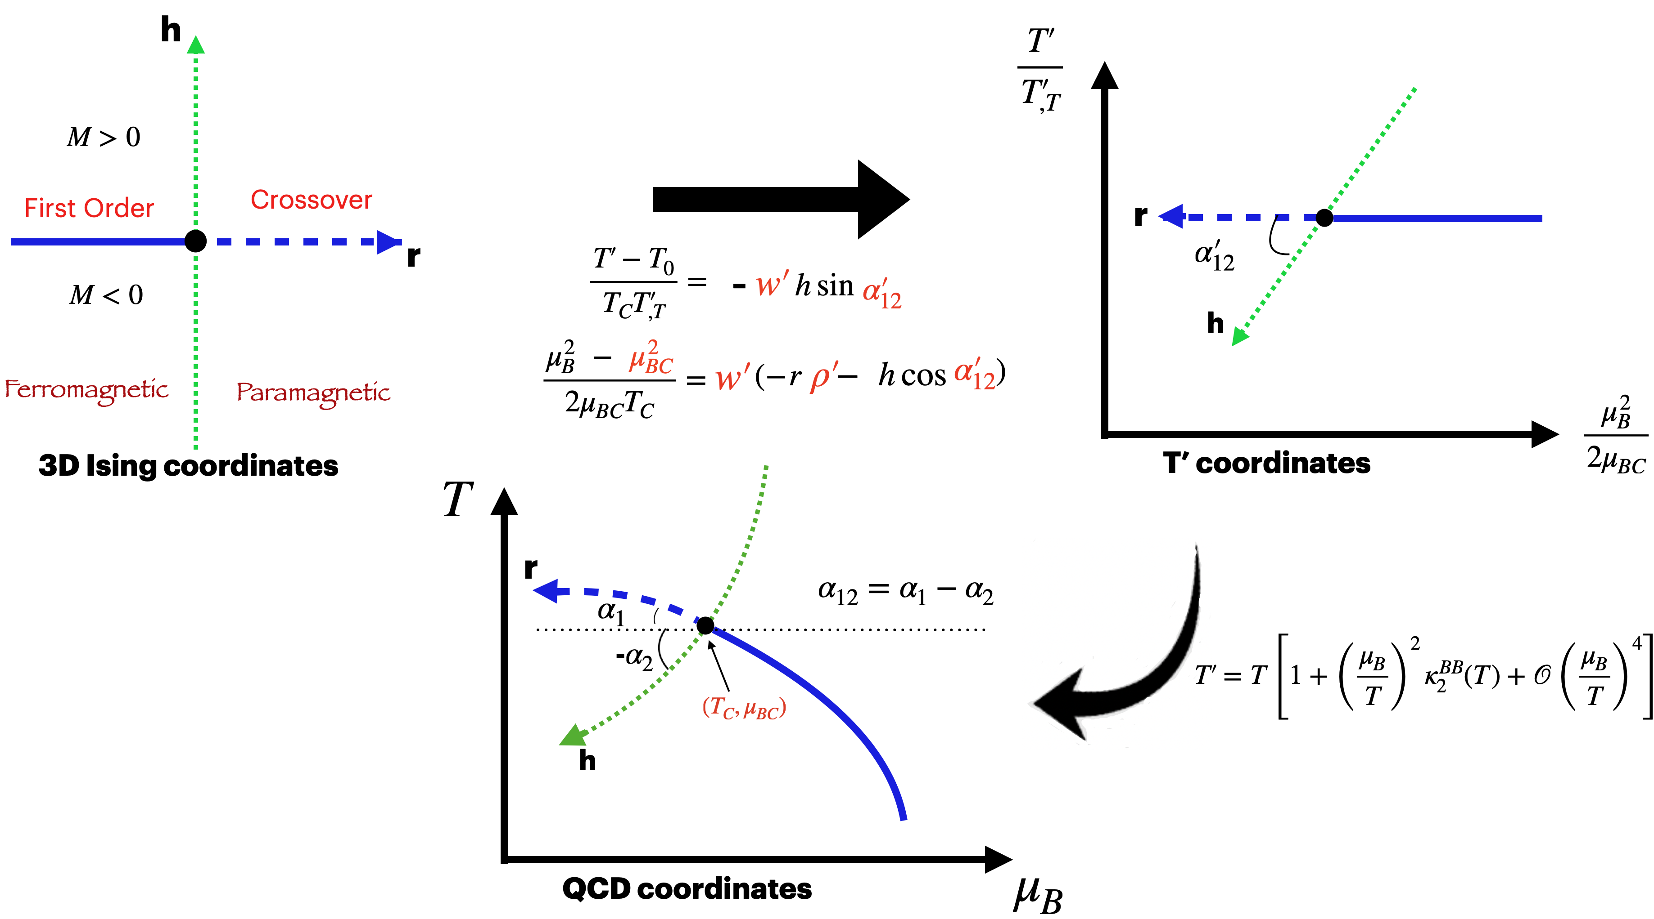
Ratti’s group
2D Ising-T.Ex.S Equation of state from l-QCD
α-RELEASE
Range: 30 MeV < T < 800 MeV ; μ_{B/Q/S} < 700 MeV
Implement scaling behavior of 3D-Ising model EoS:
Define map from 3D-Ising model to QCD
Estimate contribution to Taylor coefficients from 3D-Ising model critical point​ ​​
Reconstruct full baryon density​ ​ with​
M. Kahangirwe, J.J., C. Ratti et al., PRD (2024); arXiv:2402.08636

Slide 20
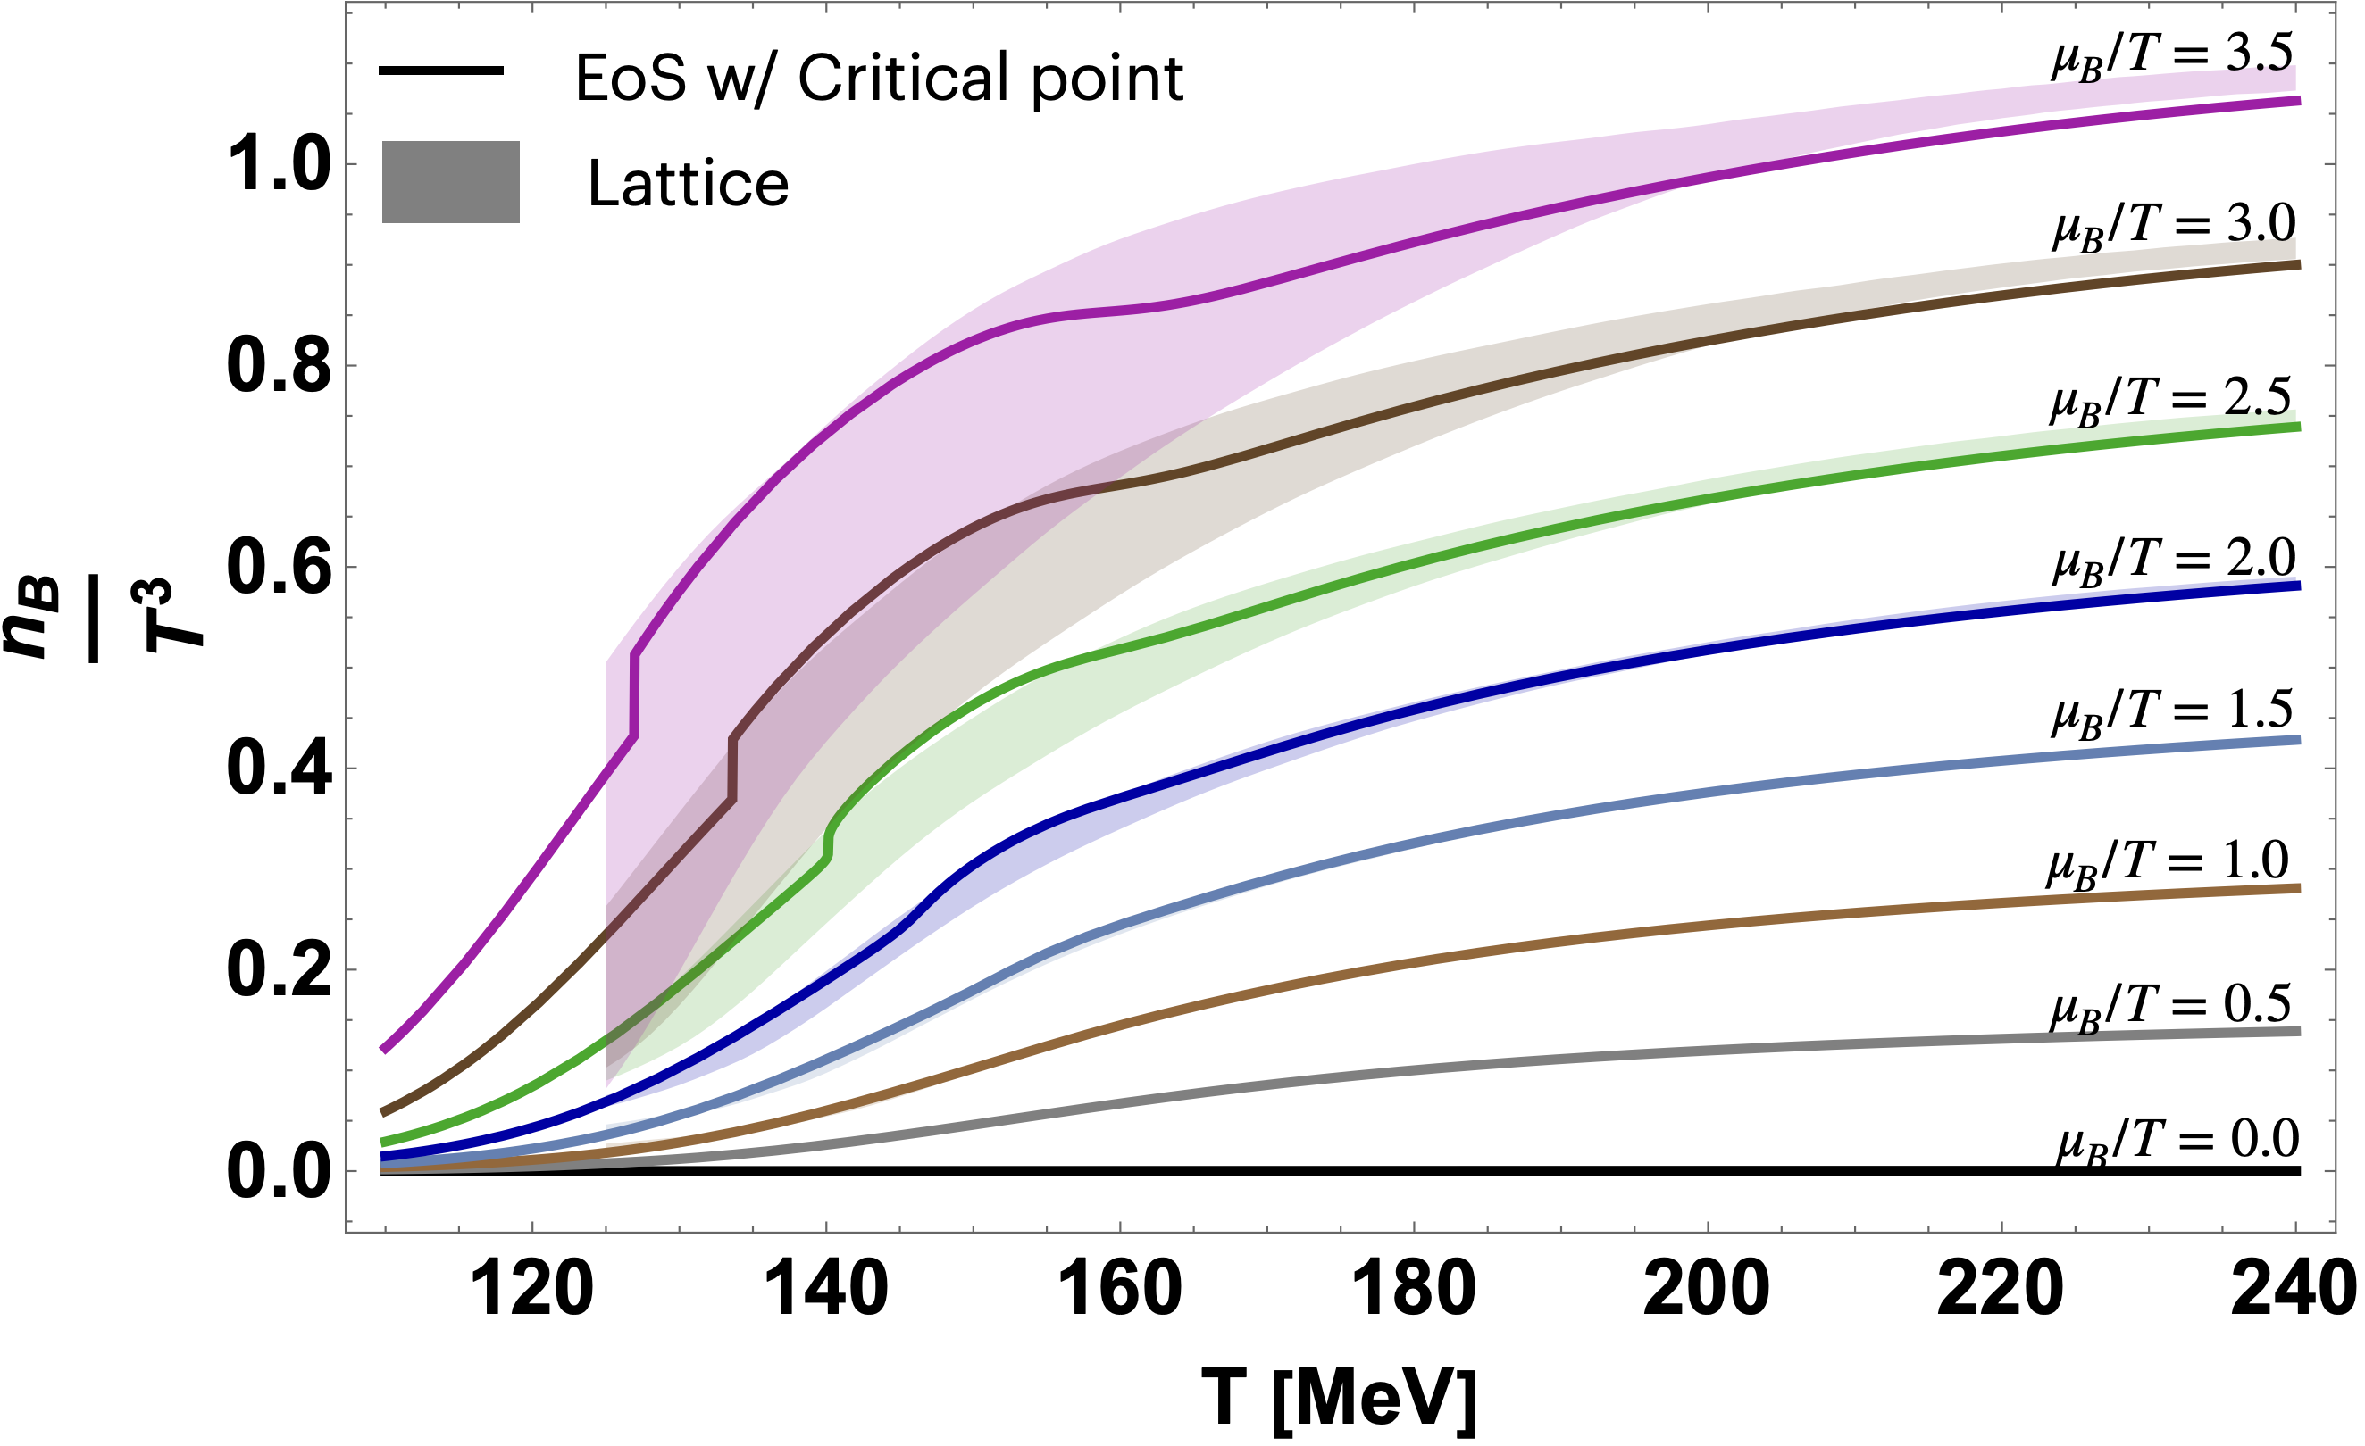
Ratti’s group
2D Ising-T.Ex.S Equation of state from l-QCD
α-RELEASE
Range: 30 MeV < T < 800 MeV ; μ_{B/Q/S} <700 MeV
Novel T'-Expansion Scheme (T.Ex.S) allows to extend lattice-based EoS up to μ_{B}/T~3.5 (EoS available at μ_{S}=μ_{Q}=0)
Includes a parametrized critical point from 3D-Ising universality class, with free location along a transition line parametrized according to physical constraints
S. Borsanyi, C. Ratti et al., PRL (2021)
S. Borsanyi, C. Ratti et al., PRD (2022)
M. Kahangirwe, J.J., C. Ratti et al., PRD (2024); arXiv:2402.08636
Outlooks:
Extend it to the case <n_{S}>=0 & <n_{Q}>=0.4<n_{B}>, relevant for HICs
Provide adaptive grid to better resolve CP
Notes:
We also have a 2D EoS with an extended coverage in mu_B, based on a new Alternative T-Expansion Scheme (AlTExS) developed recently. This expansion scheme, which is different from Taylor, allows us to push our coverage up to muB/T ~ 3.5. We have then been able to include a critical point from the 3D-Ising universality class into this EoS (only for muS=muQ=0 so far), by ensuring the conservation of the correct critical exponents. We leave to the user the freedom to choose the location of the CP along a 1st order transition line fixed by our mapping, and to parametrize the shape of the critical region.

Slide 21
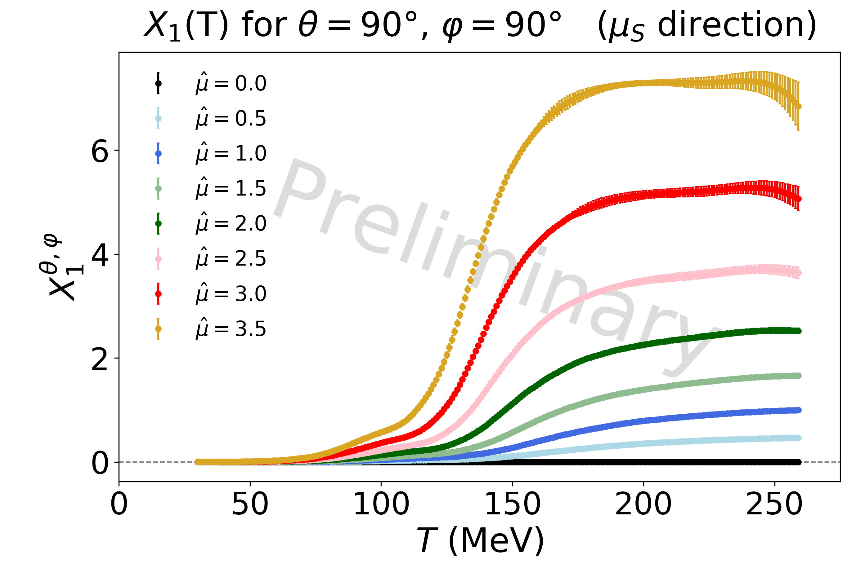
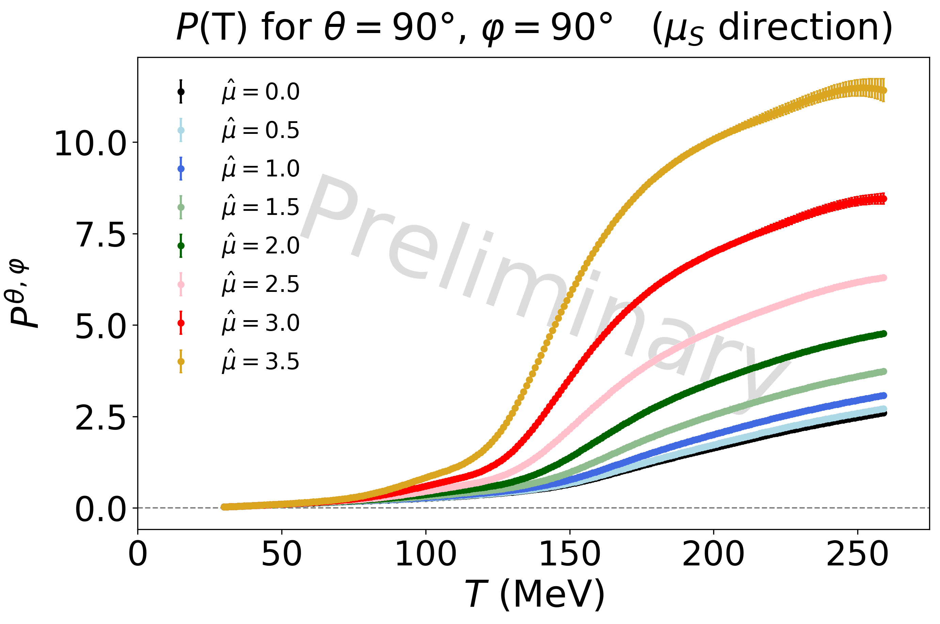
4D-T.EX.s Equation of state from l-QCD
Ratti’s group
Range: T < 800 MeV ; μ_{B/Q/S} < 700 MeV
Compute the "generalized charge density" X₁ along the projected line using the expanded temperature T' and the T.Ex.S main identity
with
Obtain pressure by integrating X₁, allowing then to compute all thermodynamics
21
Notes:
We even now have found a way to extend the Alternative T-Expansion Scheme to all 3 conserved charge chemical potentials, by redefining the coordinates from (T, μB, μQ, μS) to (T, μ, α, β) in order to obtain an expansion along a single μ line as in the 2D AlTExS described previously. The construction of the EoS remains then the same, except for the T' expansion coefficients κ, now defined as λ because computed differently. Although the formula to define λ is identical to the one defining κ coefficients, it does not employ lattice χ directly anymore, but X coefficients that are linear combinations of χ based on the angles coming from the previous change of coordinates.

Slide 22
Users
Observables for heavy-ions
Observables for neutron stars
Flavor Equilibration
Compatibility with existing codes/repositories
22
Notes:
Finally, let me talk about the users working group.

Slide 23
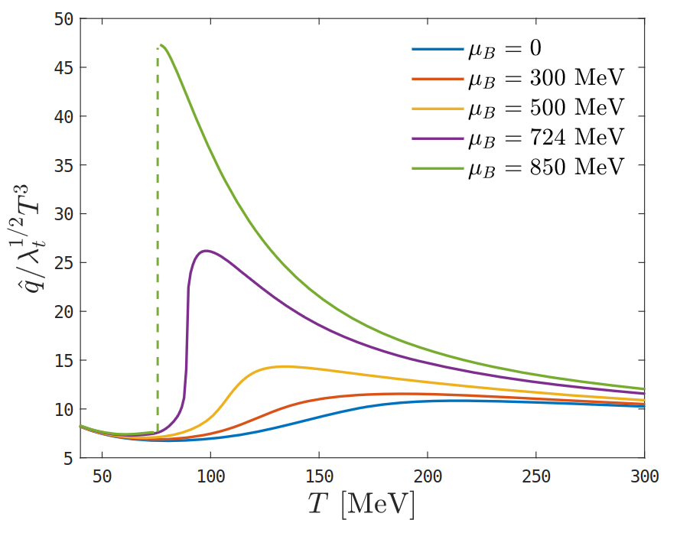
Noronha/Ratti/Vovchenko’s groups
Observables for heavy-ions
Transport coefficients from Holographic module
Thermal conductivity
Baryon conductivity & diffusion
Shear & bulk viscosities
HQ drag force & Langevin diffusion coefficients
Jet quenching parameter
Freeze-out physics
T and μ_{B} at chemical freeze-out can be fitted from experimental data with HRG
will be incorporated fromThermal-FIST
23
Notes:
In order to provide tools that are complementary to EoS calculations to the users, we will also deliver a set of packages to compute observables of interest for the HI community. - we plan to provide a package which will provide combination of contributions from different hadron family to the total pressure, from which equivalent combination for susceptibilities can be derived. Based on HRG + lQCD study, this can be used to study different contribution to criticality for instance, and to improve the quality of the proxies used in the experiment - from the Holographic module, one can get many different transport coefficients on top of the regular thermodynamics variables (list […]) - finally, using the Thermal-FIRST package, it's possible to achieve fits to extract (chemical) freeze-out properties with HRG

Slide 24
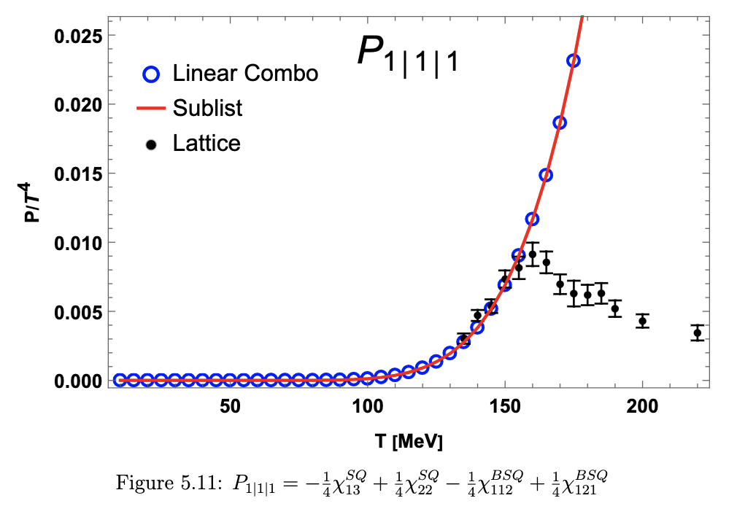
Noronha-Hostler/Ratti's groups
Observables for heavy-ions
Susceptibilities & hadronic species contributions
Susceptibilities from lattice QCD will be computable
using HRG, one can study the breakdown of different hadron families:
we will provide combinations for hadronic contributions to total pressure
we will provide analogous relations for susceptibilities
PDG21+ list
Add up all resonances from PDG (from * to *****)
Create decay channels through radiation for unknown higher energy baryons
24
Notes:
In order to provide tools that are complementary to EoS calculations to the users, we will also deliver a set of packages to compute observables of interest for the HI community. - we plan to provide a package which will provide combination of contributions from different hadron family to the total pressure, from which equivalent combination for susceptibilities can be derived. Based on HRG + lQCD study, this can be used to study different contribution to criticality for instance, and to improve the quality of the proxies used in the experiment - from the Holographic module, one can get many different transport coefficients on top of the regular thermodynamics variables (list […]) - finally, using the Thermal-FIRST package, it's possible to achieve fits to extract (chemical) freeze-out properties with HRG

Slide 25
Yunes’s group
Observables for Neutron star
QLIMR module
Given an EoS, solves the Tolmann-Oppenheimer-Volkoff (TOV) equations
and computes:
Q: quadrupole moment Q of NS
L: tidal Love number (tidal force deformability)
I: moment of inertia
M: mass of NS (+Δm to correct for rotation)
R: radius of NS (+ΔR to correct for HRG too)
Local function p(R), f(R)
α-RELEASE
25
Notes:
The first observable module for NS is the QLIMR module, which enable to calculate, from a given EoS, all the following « macroscopic » observables: […]. Then, we have a flavor equilibration module that can help to compute information regarding the composition of NS and equilibration processes: […].
We will also ensure compatibility with the CompOSE format to make sure that our EoS can be employed through the standards of the astrophysical community for NS and mergers simulations.

Slide 26
Alford/Dexheimer/Most/Yunes’s groups
Observables for Neutron STARS
Flavour equilibration
β-equilibrium (by balancing rates)
Given an EoS, computes:
Urca rates ( n p + e + ν_{e} / p + e n + ν_{e})
Equilibrium charge fractions
Relaxation rates
Damping time
Susceptibilities (another module?)
Bulk viscosity
Lepton module
Takes in nuclear EoS
Compute the charged lepton densities necessary to ensure having charge neutrality
α-RELEASE
α-RELEASE
Outlooks:
include neutrinos
include photons … "Electroweak module"?
Adapter modules for NS & mergers simulation tools
Ensuring compatibility with CompStar Online Supernovae Equations of State (CompOSE), a standard format, with the aim to provide thousands of 1D/2D/3D EoS tables for NS
Ensuring compatibility with merger simulations
26
Notes:
The first observable module for NS is the QLIMR module, which enable to calculate, from a given EoS, all the following « macroscopic » observables: […]. Then, we have a flavor equilibration module that can help to compute information regarding the composition of NS and equilibration processes: […].
We will also ensure compatibility with the CompOSE format to make sure that our EoS can be employed through the standards of the astrophysical community for NS and mergers simulations.

Slide 27
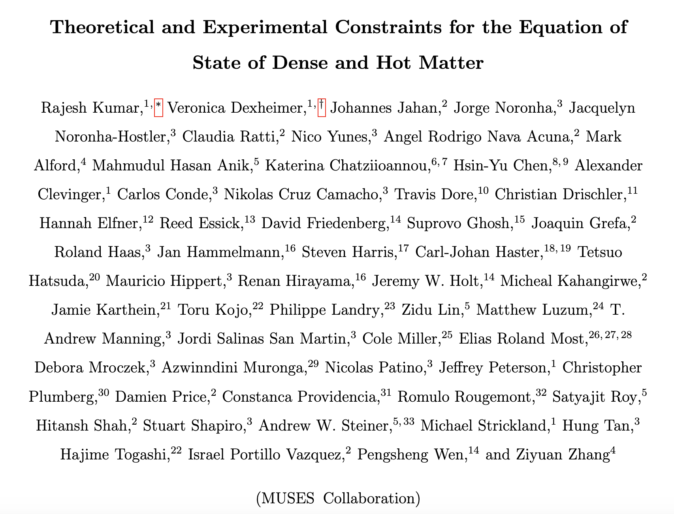
First muses-wide publication!
Just accepted for publication in Living Reviews in Relativity
arXiv:2303.17021
27
Notes:
Our first collaboration-wide publication, released in March 2023, was an attempt to review all theoretical and experimental constraints for the nuclear EoS at finite T and mus.

Slide 28
Conclusions
MUSES will provide a modular unified solver for the equation of state and calculate observables of relevance for the heavy-ion and astrophysics communities
α-release planned for May 2024 (to be available for some selected users)
3 modules for NS EoS
3 modules for HI EoS
3/4 observable modules
Most modules have plans for improvement (-> 1.1.0)
28
Notes:
So to conclude, we are very excited to start working on the MUSES project. MUSES will provide a cyberinfrastructure delivering EoS tables and related observables which are of need for HIC modeling and NS & mergers simulations, with new tools to help merging consistently different types of EoS, and ensure a maximal coverage of the phase diagram.

Slide 29
Backup slides

Slide 30
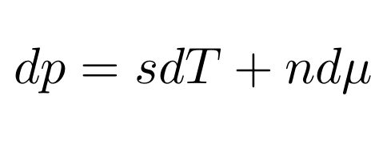
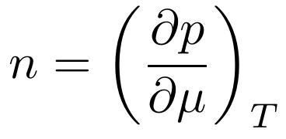
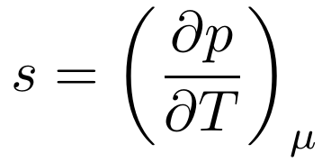
Thermodynamics relations
Notes:
Let me go a bit more into the physics details. If we were able to solve QCD at high density, none of this would be necessary. QCD can only be solved numerically through lattice simulations in the range of temperature and density relevant to both heavy-ion and neutron star communities. However, this numerical technique is based on Monte Carlo importance sampling, which cannot be applied at finite density because the quantity used to sample the configurations becomes complex and cannot be used as a weight anymore. This is the reason why we don’t know the equation of state and phase diagram of strongly interacting matter at all temperatures and densities from first principles. We need to rely on models to explore the regions which lattice QCD cannot reach yet.

Slide 31
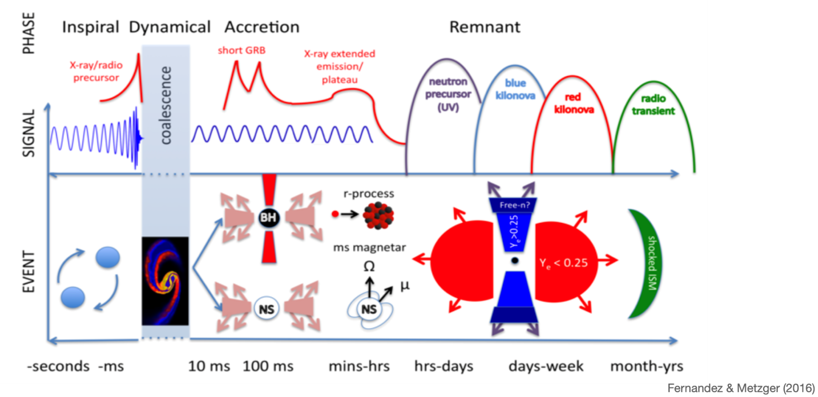
Anatomy of a Neutron star MERGER
31
Notes:
This cartoon shows phases of a NS merger as a function of time, showing the associated observational signatures and underlying physical phenomena. Nuclear physics, with possible answers to the open questions listed at the beginning, is encoded in all phases.

Slide 32
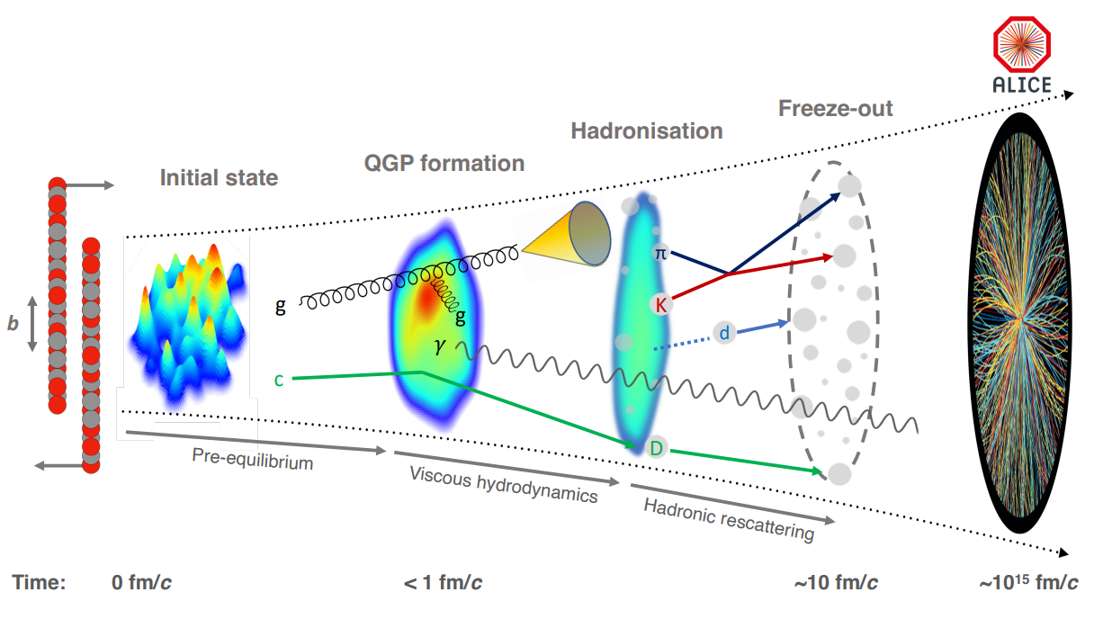
Anatomy of a heavy-ion collision
The ALICE experiment: A journey through QCD, CERN-EP-2022-227 (2022)
32
Notes:
Coming back to Earth now, let's discuss how we probe the phase diagram of nuclear matter at very small scales. This cartoon represents the scenario of a HIC, and the different phases through which the system will evolve. One can see that such experiments allow to probe dynamically different phases of the phase diagram, and in particular phase transitions, in its different regions depending on the center-of-mass energy of the collision.

