Slide 1
MUSES Status Report – Flavor Equilibration Module
Mark Alford, Ziyuan Zhang

Slide 2
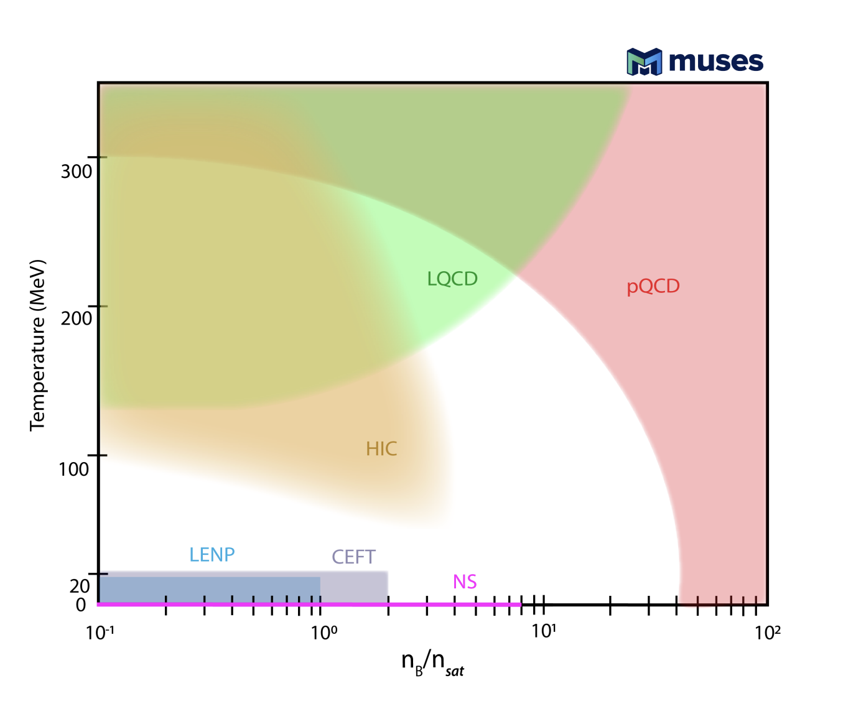
Neutron Star Mergers in the QCD Phase Diagram
Neutron star mergers probe high density, low to intermediate temperature part of the QCD phase diagram.
Use mergers to study properties of dense matter. Mergers are dynamic, so equilibration is important.
Provide code to calculate properties related to flavor equilibration.
NSM
arxiv: 2303.17021

Slide 3
Flavor Equilibration
Flavor Equilibration
When density oscillations push proton fraction out of equilibrium, it is equilibrated by the Urca processes
decompress
Urca processes (nu-transparent regime for now)
Proton Fraction
compress
$n+…→p+e^{−}+…$
$p+e^{−}+…→n+…$
Flavor equilibration can affect mergers (eg. bulk viscosity)
Density
Notes:
Switch 1st and 2nd bullet point;; plots with 3 cases

Slide 4
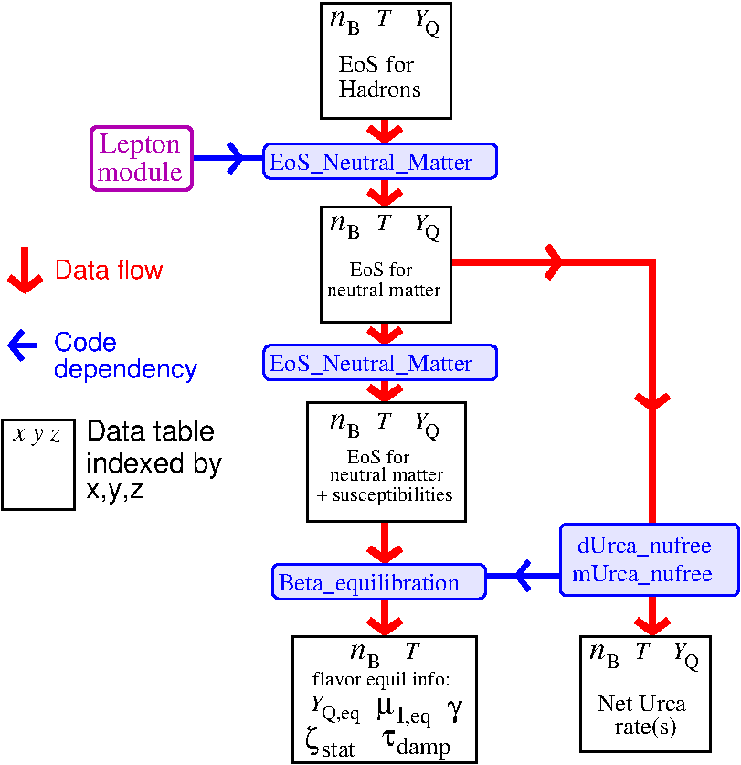
Structure of the Module
Input
EoS with nucleon dispersion relations
Output
Urca rates $Γ(n_{B}, T, Y_{Q})$
Flavor equilibration information
$Y_{Q,eq}(n_{B}, T)$ eq. charge fraction
$μ_{I,eq}\left(n_{B}, T\right)$ eq. isospin chem. pot.
$γ(n_{B}, T)$ relaxation rate
$ζ_{stat}(n_{B}, T)$ static bulk viscosity
$τ_{damp}(n_{B}, T)$ damping time
Notes:
Columns of the data table

Slide 5
Format (for Users)
The OpenAPI specification specifies the requirements for the input and output files
/input/eos.yaml
/input/config.yaml
(let user specify parameters)
/output/Urca_rate.yaml
(tabulates Urca rates)
/output/flavor_equilibration.yaml (tabulates flavor equilibration related information)
$$n_{B}$$ | $$T$$ | $$Y_{Q}$$ | $$p_{B}$$ | $$e_{B}$$ | $$s_{B}$$ | $$μ_{n}$$ | $$μ_{p}$$ | $$m_{n}^{∗}$$ | $$m_{p}^{∗}$$ | $$U_{n}$$ | $$U_{p}$$
$$n_{B}$$ | $$T$$ | $$Y_{Q}$$ | $$Γ_{net}$$
$$n_{B}$$ | $$T$$ | $$Y_{Q,eq}$$ | $$μ_{Q,eq}$$ | $$γ$$ | $$ζ_{stat}$$ | $$τ_{damp}$$

Slide 6
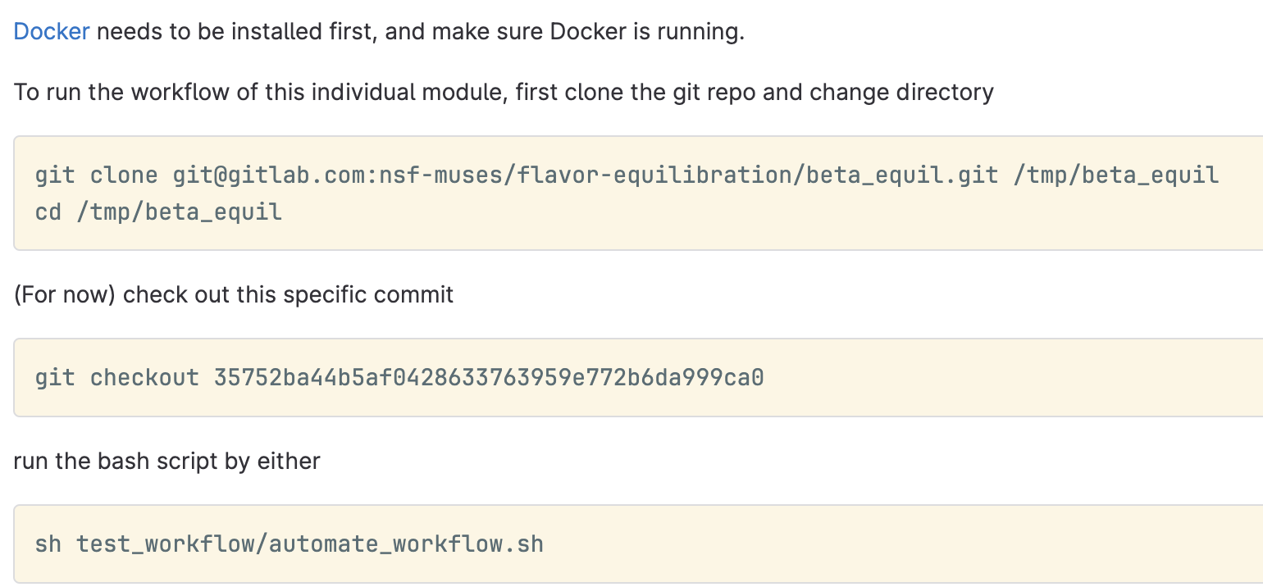
Containerization and User Instructions
Have containerized the module using Docker (with all dependencies packed up). Should be platform-independent.
The easiest way for a user to run the module:
Notes:
Columns of the data table

Slide 7
Summary – Flavor Equilibration Module
Purpose
Provide code to calculate Urca rates and flavor equilibration related dense matter properties.
Current Status
Completed Python code that can calculate Urca rates, equilibrium charge fraction, relaxation rates, susceptibilities, bulk viscosity, damping time.
Containerized the module using Docker. Working on integration to the calculation engine.
Writing a paper on flavor equilibration using the module code.
Investigated Gaussian process interpolation as a better interpolator.
Future Plans
Possible expansions of the functionality. (npe$μ$ matter, neutrino-trapped regime, Urca rates with arbitrary neutrino distribution function, etc.).
Possible usage of Gaussian process interpolation for MUSES.

Slide 8
